Slide 1
Lesson12 Differentiation & Integration of Trigonometric Functions Interactive Seminar
E114 – Mathematics for Engineering

Slide 2
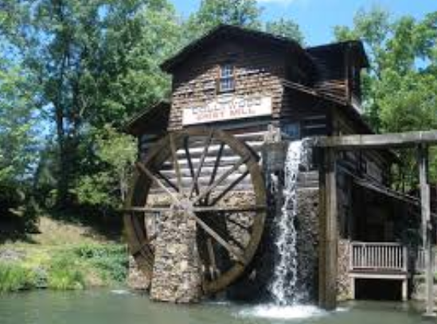
Scenario
Consider a water wheel similar to that in Lesson 02 with radius of 1 unit and rotational speed of 1 radian per second.
Consider a point P on the wheel as before and let h and w be its vertical and horizontal displacements respectively as shown below.
Express the rate of change of h and w as functions of time t in seconds.
Conversely, how would you find the displacement function when the rate of displacement function is given?
How do r, rotational speed, shifting of the wheel vertically affect the rate of change of h and w?
P
r
h
θ
w
Source: https://www.thinglink.com/scene/631941982796644354

Slide 3
Scenario Definition Template
What do we know?
What do we not know?
What do we need to find out?
3

Slide 4
Lesson overview
S/N | Concepts | Slide Number
1 | Basic Trigonometric Functions | 5
2 | Explore! activity | 6
3 | Differentiation of sine function | 7-13
4 | Differentiation of cosine function | 14-16
6 | Differentiation of trigonometric functions | 17-19
7 | Integration of sine function | 21-23
8 | Integration of cosine function | 24-27
9 | Definite integrals of trigonometric functions | 28-30
10 | Summary of Differentiation and Integration | 31
11 | Applications (CL) | 32-35

Slide 5
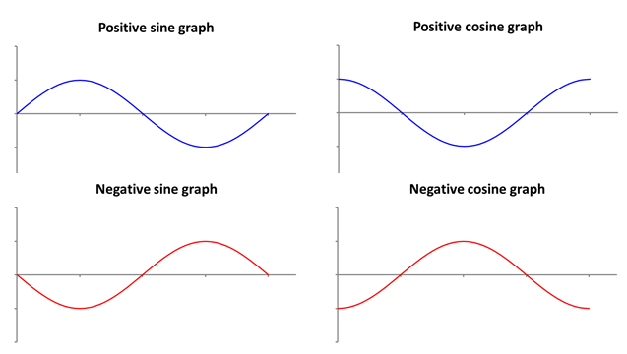
Basic Trigonometric Functions (Recall)
Sine and Cosine are two basic trigonometric functions that have the following characteristics:
Cyclical / periodic
Maximum / minimum values
y = A sin(Bθ+C)+D
y = A cos(Bθ+C)+D
5

Slide 6
Explore!
Open the Excel file and follow the instructions:
Select sine graph: y = A sin(Bθ+C)+D
Change the parameters for A, B, C, D one at a time and observe how the sine graph and its derivative changes.
Ask yourself these questions:
How does rate of change of sine graph look like?
How does A affects the rate of change of sine graph?
What about B, C and D then?

Slide 7
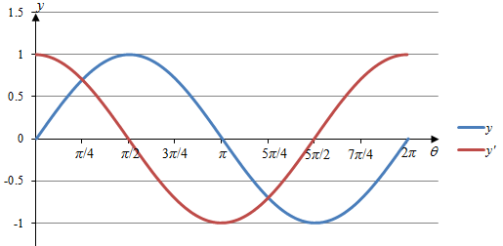
Differentiation of sine function
The graph of the rate of change of sine graph looks similar to a cosine graph.
The gradients at the maximum and minimum points of sine graph are also zero (also known as instantaneously at rest).
The gradients at the points where the sine graph cuts the θ -axis are either at their maximum or minimum.

Slide 8
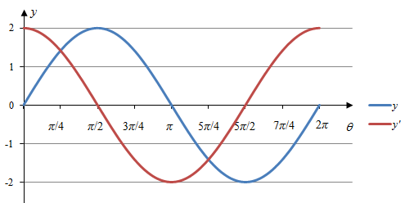
Differentiation of sine function
The amplitude of the rate of change of graph is 2.
The amplitude of sine graph and its rate of change graph is the same.

Slide 9
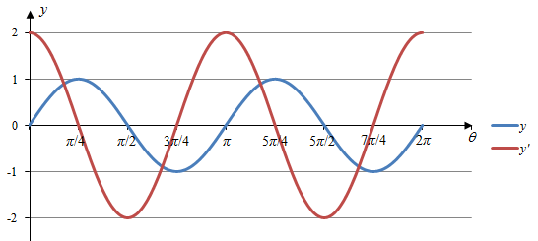
Differentiation of sine function
The number of cycles for the rate of change of graph is the same, i.e. 2.
However, the amplitude of the rate of change graph is double of that of .

Slide 10
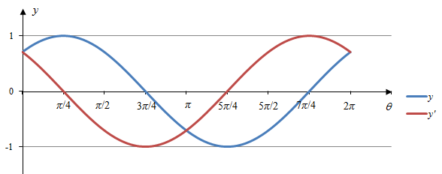
Differentiation of sine function
The amplitude and number of cycles for graph is the same as its rate of change graph.

Slide 11
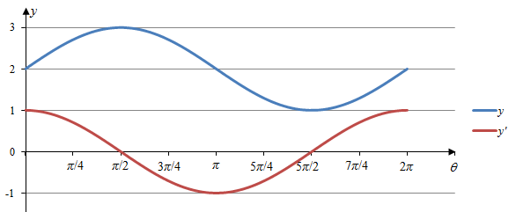
Differentiation of sine function
The rate of change of graph is not affected by the shift along y-axis.

Slide 12
Differentiation of sine function
[Example]
Differentiate . Calculate the gradient when .
Keep the same! Do not change what is inside the trigo, i.e. (Bθ + C)
[Solution]
Correct?
Use radian mode in calculator!
When

Slide 13

Test yourself
Differentiate these sine functions
(a)
(b)
13

Slide 14
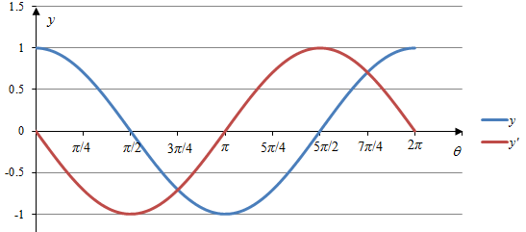
Differentiation of cosine function
The graph of the rate of change of cosine graph looks similar to a negative sine graph.
The gradients at the maximum and minimum points of cosine graph are also zero (also known as instantaneously at rest).
The gradients at the points where the cosine graph cuts the θ -axis are either at their maximum or minimum.

Slide 15
Differentiation of cosine function
[Example]
Differentiate
Keep the same! Do not change what is inside the trigo, i.e. (Bθ + C)
[Solution]
Correct?

Slide 16
Test yourself
Differentiate the following functions:
(a)
(b)
16

Slide 17
Differentiation of trigonometric functions
In summary, the rate of change (also known as differentiation) of trigonometric functions can be expressed and summarised as shown below:
where a is a constant and f(x) is any function of x.
17

Slide 18
Differentiation of trigonometric functions
[Example] Differentiate the following:
[Solution]
Correct?
No change!
18

Slide 19
Think-Pair-Share
Differentiate the following function:
19

Slide 20
BRAIN BREAK
"Nothing is impossible, the word itself says 'I'm possible'!" - Audrey Hepburn

Slide 21
Integration of sine function
Integration can be seen as the process of reversing the differentiation.
Previously:
When integrating the negative sine function, we have:
where c is a constant
Hence integrating a sine function gives:

Slide 22
Integration of sine function
Similarly,
Hence,
where A, B, C and c are constants.

Slide 23
Test Yourself
Integrate the following functions:
(a)
(b)
23

Slide 24
Integration of cosine function
Integration can be seen as the process of reversing the differentiation.
Previously:
When integrating the cosine function, we have:
where c is a constant
24

Slide 25
Integration of cosine function
Similarly,
Hence,
where A, B, C and c are constants.

Slide 26
Test Yourself
Integrate the following functions:
(a)
(b)
26

Slide 27
Definite integrals
[Example]
Evaluate the following definite integral:
Correct?
Use radian mode in calculator!
27

Slide 28
Test Yourself
Evaluate the following definite integral:
28

Slide 29
Think-Pair-Share
Integrate the following expression:
(Hint: use trigonometric identities)

Slide 30

Kahoot.it!
30

Slide 31
Summary
Differentiation:
Integration:
Type of function | f (x) | f′ (x)
Algebraic | f (x) = ax^{n} | f′ (x) = anx^{n} ^{– 1}
Trigonometric | f (x) = asin(bx + d) | f′ (x) = abcos(bx + d)
 | f (x) = acos(bx + d) | f′ (x) = –absin(bx + d)
Type of function | f′ (x) | f (x)
Algebraic (for ) | f′ (x) = ax^{n}
Trigonometric | f′ (x) = asin(bx + d)
 | f′ (x) = acos(bx + d)

Slide 32
Recall: Applications (CL)
Quantity function
f (t)
Differentiate
Rate of change function
f '(t)
Integrate
Differentiate
Displacement function
s(t)
Velocity function
v(t)
Integrate
Velocity function
v(t)
Differentiate
Acceleration function
a(t)
Integrate

Slide 33
Applications (CL)
Max displacement = amplitude
[Example] A simple pendulum has a length of 1 m and a maximum horizontal displacement of 5 cm. The period of the pendulum is 2 seconds. The horizontal position of the pendulum is modelled by the equation where A is the amplitude, T is the period and t is the time in seconds. Determine the horizontal velocity and acceleration of this pendulum at t = 3 s.
[Solution] Given A = 5, T = 2,
1 m
5 cm
33

Slide 34
Think-Pair-Share (CL)
A mass hanging from a spring is set in motion and its velocity is given by , for t ≥ 0 seconds.
Assume that the positive direction is upwards and s(0) = 10 m. Determine the position function.

Slide 35
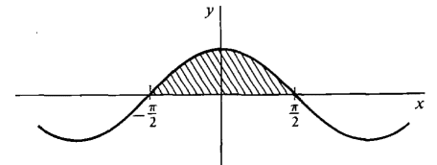

Test yourself (CL)
Find the area under the following graph of $,$
from .

Slide 36
One-minute write
Please stop what you are doing and produce a written response to either of the following in only one minute:
Identify what is the key learning concepts from the seminar, or
Write down a question with respect to the concepts learnt so far.
Link:

Slide 37
Learning Objectives
Perform differentiation and integration of a trigonometric function.
Model and solve real-world problems involving differentiation and integration of trigonometric functions (e.g. simple pendulum) (CL)

